Slide 1


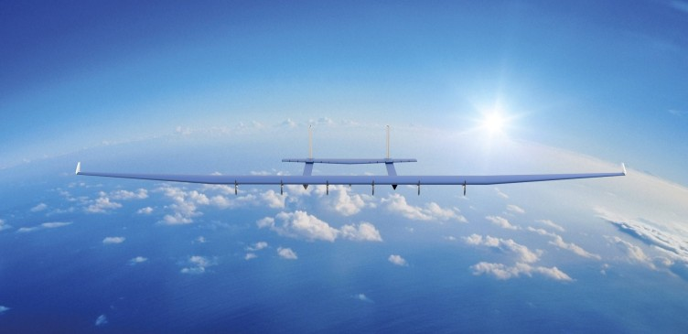
Design Team
Department of Aerospace Engineering
HAP
High Altitude Platform
UAV- Pre Presentation
Batch 2020
B-Tech in Aerospace Engineering
CL: Dr. Jayahar Sivasubramanian

Slide 2

Design Team
Astro X Team Details
A U Nachiketh Kumar 20ETAS012001
Ruturaj Jadhav 20ETAS012305
Alqma Khatib 20ETAS012302
Kartavya Yadhav 20ETAS012014
Harshvardhan More 20ETAS012012
Supervisor
Dr. Jayahar Sivasubramaniam
B-Tech is Aerospace Engineering
FET, Batch 2020

Slide 3

Design Team
Presentation Outline
Hale UAV
Objectives
UAV Comparision
Design Methodology
Conclusion
Reference

Slide 4
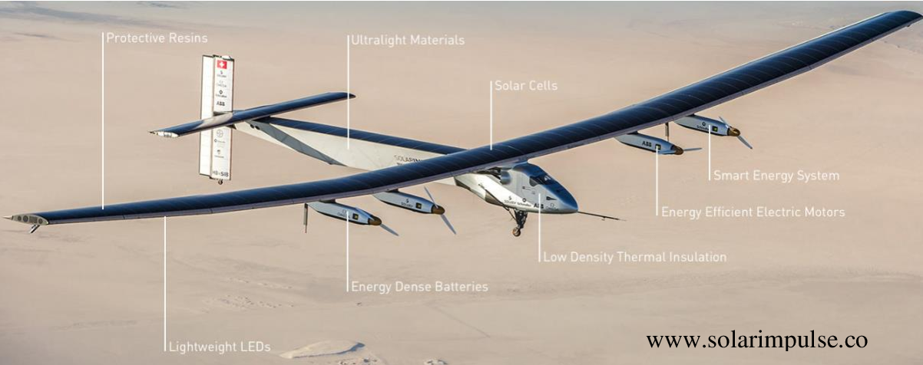
Design Team
HALE
High Altitude Long Endurance
Presentation Outline
A High-Altitude Long-Endurance Unmanned Aerial Vehicle (HALE UAV) is an unmanned aircraft designed for extended flight at high altitudes.
These drones can fly at altitudes exceeding 50,000 feet and remain airborne for hours to days.
HALE UAVs are often equipped with advanced technology, autonomous operation, and the ability to carry various payloads, making them valuable for missions like surveillance, communication relay, and research.
Proprieties
Application
High Altitude
Long Endurance
Solar Power
Payload Flexibility
Autonomous Operation
Surveillance and Reconnaissance
Communication Relay
Scientific Research
Commercial and Civilian Uses

Slide 5
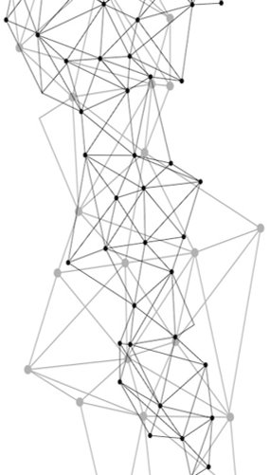
Design Team
Objectives
Estimation and minimizing the weight and the power requirement of the UAV for better performance
Selection and implementation of the onboard systems crucial for flight and corresponding power consumed
Aerodynamic analysis of the UAV designed
Structural layout and material selection for a lightweight aircraft to support all the loads acting on the UAV
Hale UAV
Objectives
UAV Comparision
Design Methodology
Conclusion
Reference

Slide 6
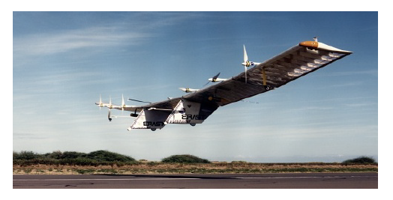
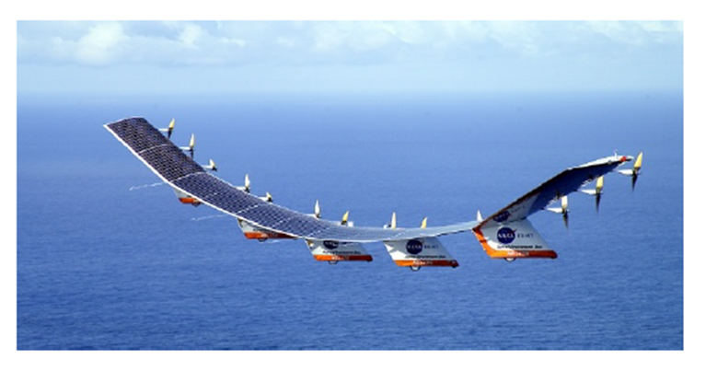
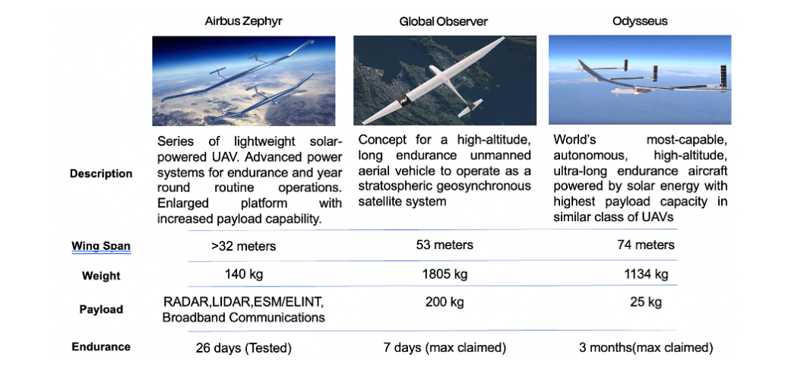
Design Team
Market Study
pathfinder
Helios
Hale UAV
Objectives
UAV Comparision
Design Methodology
Conclusion
Reference

Slide 7
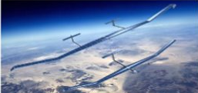
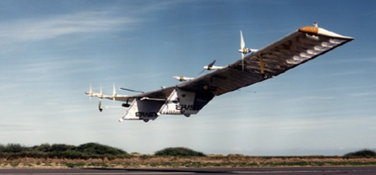
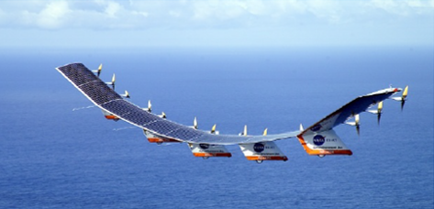
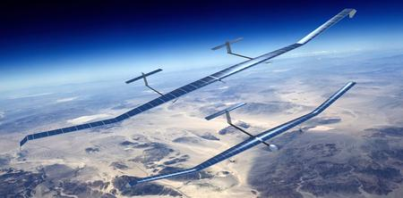
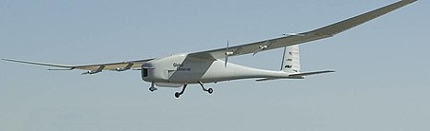
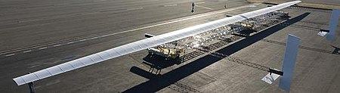
Design Team
Market Study
Names | Pathfinder | Helios HP03 | Zephyr | Airbus Zephyr | Global Observer | Odysseus
Fuselage Length (m) | 3.6 | 5 | 3.6 | 25 | 21 | 35
Chord (m) | 2.4 | 2.4 | 2.4 | 2.4 | 3 | 5
Endurance(day) | 1 | 1 | 26 | 26 | 7 | 90
Wingspan (m) | 29.5 | 30 | 25 | 25 | 53 | 74
Aspect ratio | 15 | 15 | 12 | 12 | 18 | 15
Max altitude (km) | 21 | 20 | 21 | 23 | 20 | 20
Max. weight (kg) | 252 | 1052 | 62 | 140 | 1225 | 880
Payload (kg) | 45 | 90 | 5 | 5 | 180 | 25
Engines | electric, 2 hp (1.5 kW) each | electric, 2 hp (1.5 kW) each | electric, 2 hp (1.5 kW) | electric, 2 hp (1.5 kW) | electric, 2 hp (0.5 kW) | electric, 3 hp (2.2 kW)
No. of engines | 6 | 10 | 6 | 6 | 4
Solar pwr output (kW) | 7.5 | 18.5 | 7.5 | 18.5
Supplemental power | batteries | Li batteries, fuel cell | batteries | Li batteries, fuel cell | Liquid Hydrogen Power | Li batteries, fuel cell

Slide 8
Design Team
Market Study
Airbus Zephyr:
Description: The Airbus Zephyr is a High-Altitude Pseudo-Satellite (HAPS) designed to operate in the stratosphere for extended periods. It is a solar-powered, lightweight, and unmanned aircraft that provides persistent surveillance, communication, and data collection capabilities.
Endurance | 26 days
Altitude | 23 km
Global Observer:
Description: The Global Observer is a High-Altitude Long-Endurance (HALE) UAV developed by AeroVironment. It is designed for stratospheric, long-duration missions, capable of providing surveillance, reconnaissance, and communication relay services.
Endurance | 7 days
Altitude | 20 km
Pathfinder:
Description: The Pathfinder UAV is an early solar-powered aircraft developed by NASA. It was a pioneering High-Altitude, Long-Endurance (HALE) drone that demonstrated the feasibility of using solar power for extended flight in the stratosphere.
pathfinder
Endurance | 1 days
Altitude | 21 km

Slide 9
Design Team
Market Study
Helios:
Description: Helios, also developed by NASA, was a solar-powered, remotely piloted aircraft designed for high-altitude, long-endurance missions. It aimed to reach the edge of space (stratosphere) and performed scientific research and technology demonstrations.
Odysseus UAV:
Description: The Odysseus UAV is a high-altitude, solar-electric, autonomous drone developed by Aurora Flight Sciences. It is designed to stay aloft in the stratosphere for an extended duration, offering communication relay, surveillance, and environmental monitoring capabilities.
Helios
Endurance | 1 days
Altitude | 20 km
Endurance | 90 days
Altitude | 20 km

Slide 10
Design Team
Presentation Outline
Hale UAV
Objectives
UAV Comparision
Design Methodology
Conclusion
Reference

Slide 11
Design Team
Presentation Outline
Hale UAV
Objectives
UAV Comparision
Design Methodology
Conclusion
Reference

Slide 12
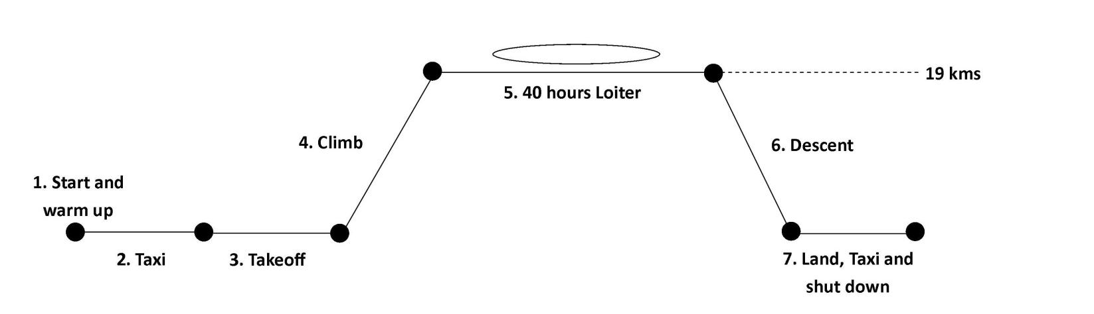
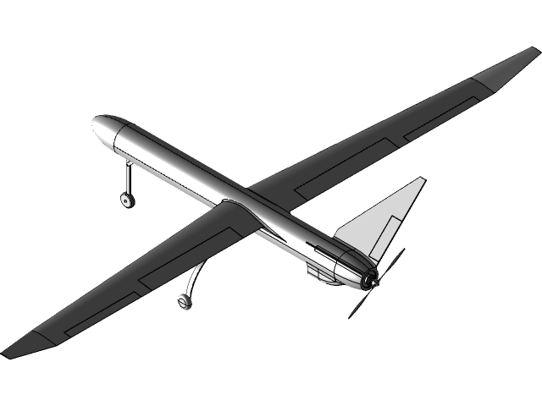
Design Team
Mission Profile

Slide 13
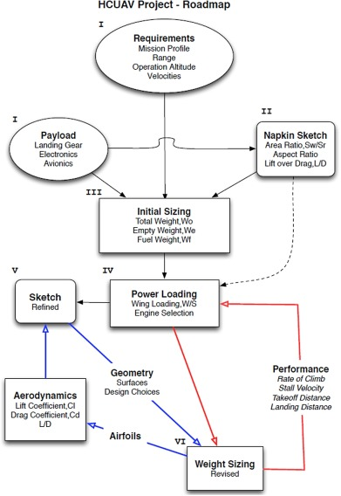
Design Team
Design Methodology
Methodology Steps:
Finalized Requirments
Initial Estimation of Design Parameters
Weight Details
Initial Sizing
Constraint Analysis
Aerodynamic parameter Calculations
Refined Sizing
Performance Calculation
Finalized Design
Presentation Outline

Slide 14
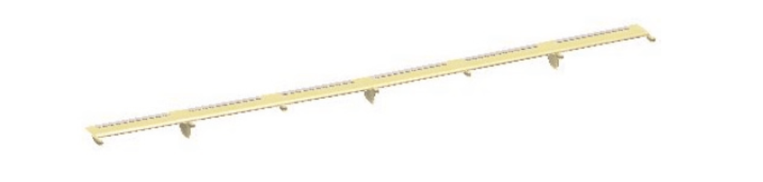
Design Team
Configuration Selection
Prior to determining the overall configuration, an analysis on different types of configurations was performed. The first type of configuration is the flying wing configuration as shown:
This type of configuration is good if the weight is evenly distributed over the span of the wing, however referring back to the Helios crash incident our design would encounter the same excessive dihedral problems

Slide 15
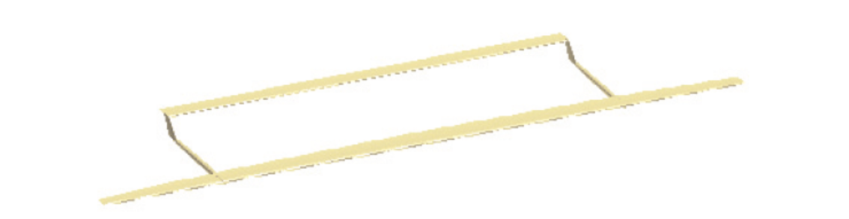
Design Team
Configuration Selection
Building upon the previous configuration another design was the twin boom tail configuration, the twin tails increase the structural and overall stability of the UAV but again the same dihedral problems were encountered in the final design as with the flying wing configuration hence this too proved to be unviable.

Slide 16
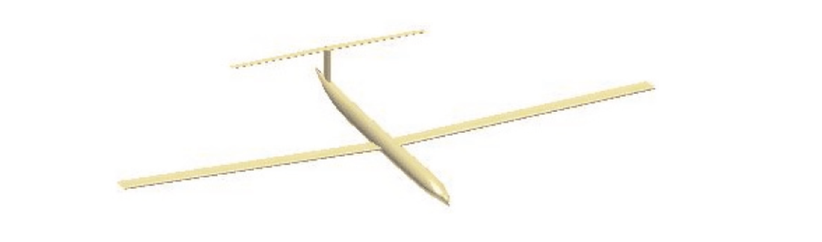
Design Team
Configuration Selection
The third type of configuration is the conventional configuration, as shown; this type of configuration is mostly commonly used today. This configuration is the best choice due to the majority of weight being distributed in the center of the aircraft also building upon the aircraft stability although this is traded off for aerodynamic efficiency.

Slide 17
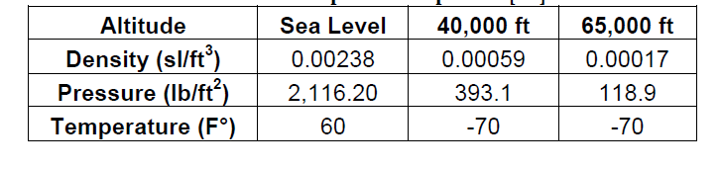
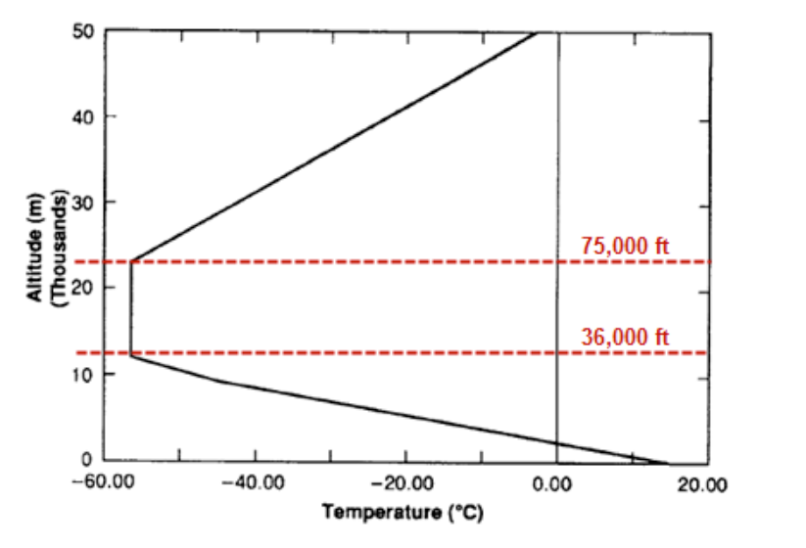
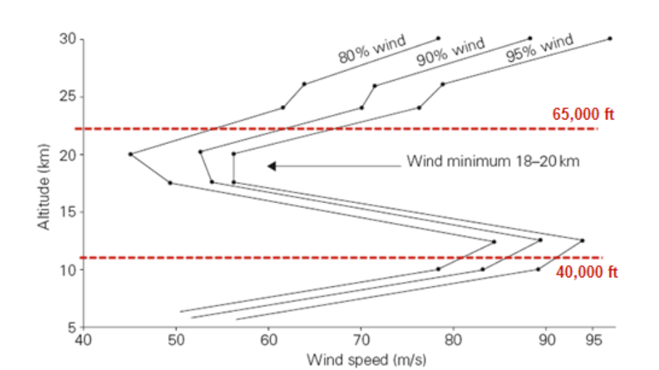
Design Team
Indian Standard Atmosphere
Indian Standard Atmosphere model
For all the upcoming calculation the Indian standard atmospheric data are used. The data values are mentioned above.

Slide 18
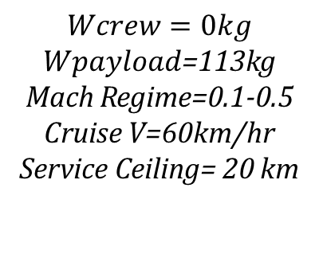
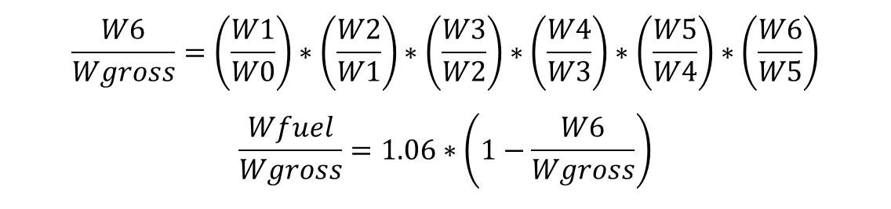

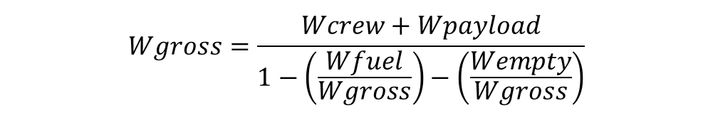
Design Team
Initial Sizing
Requirments
𝑊𝑜 = 𝑊𝑐𝑟𝑒𝑤 + 𝑊𝑝𝑎𝑦𝑙𝑜𝑎𝑑 + 𝑊𝑓𝑢𝑒𝑙 + 𝑊𝑒𝑚𝑝𝑡𝑦
$$Wcrew=0kg$$
$Wpayload$=113kg
Mach Regime=0.1-0.5
Cruise V=60km/hr
Service Ceiling= 20 km
$$Wgross=\frac{Wcrew+Wpayload}{1−\left(\frac{Wfuel}{Wgross}\right)−\left(\frac{Wempty}{Wgross}\right)}$$
$$\frac{Wempty}{Wgross}= 1.05∗\left({\left(estimatedWgross\right)}^{−0.05}\right)∗1$$
$$\frac{W6}{Wgross}=\left(\frac{W1}{W0}\right)∗\left(\frac{W2}{W1}\right)∗\left(\frac{W3}{W2}\right)∗\left(\frac{W4}{W3}\right)∗\left(\frac{W5}{W4}\right)∗\left(\frac{W6}{W5}\right)$$
$$\frac{Wfuel}{Wgross}=1.06∗\left(1−\frac{W6}{Wgross}\right)$$

Slide 19
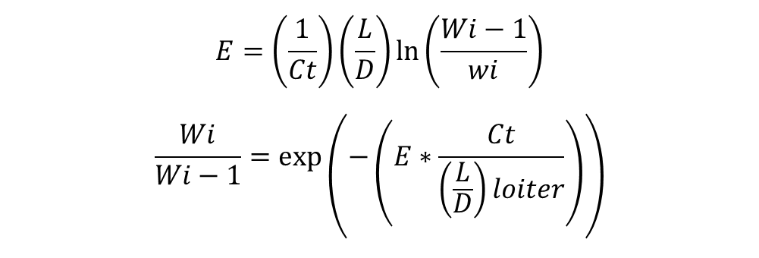
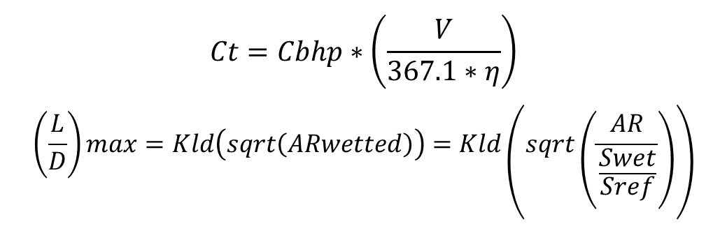
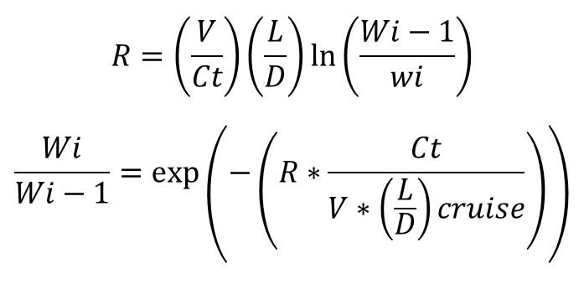
Design Team
Initial Sizing
Weight Estimation during Cruise
Weight Estimation during Loiter
Presentation Outline
$$R=\left(\frac{V}{Ct}\right)\left(\frac{L}{D}\right)\ln\left(\frac{Wi−1}{wi}\right)$$
$$\frac{Wi}{Wi−1}=\exp\left(−\left(R∗\frac{Ct}{V∗\left(\frac{L}{D}\right)cruise}\right)\right)$$
$$E=\left(\frac{1}{Ct}\right)\left(\frac{L}{D}\right)\ln\left(\frac{Wi−1}{wi}\right)$$
$$\frac{Wi}{Wi−1}=\exp\left(−\left(E∗\frac{Ct}{\left(\frac{L}{D}\right)loiter}\right)\right)$$
$$Ct=Cbhp∗\left(\frac{V}{367.1∗η}\right)$$
$$\left(\frac{L}{D}\right)max=Kld\left(sqrt\left(ARwetted\right)\right)=Kld\left(sqrt\left(\frac{AR}{\frac{Swet}{Sref}}\right)\right)$$

Slide 20
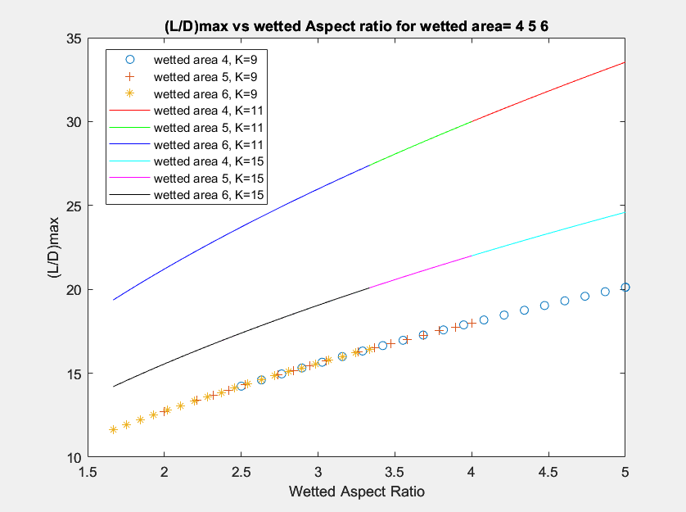
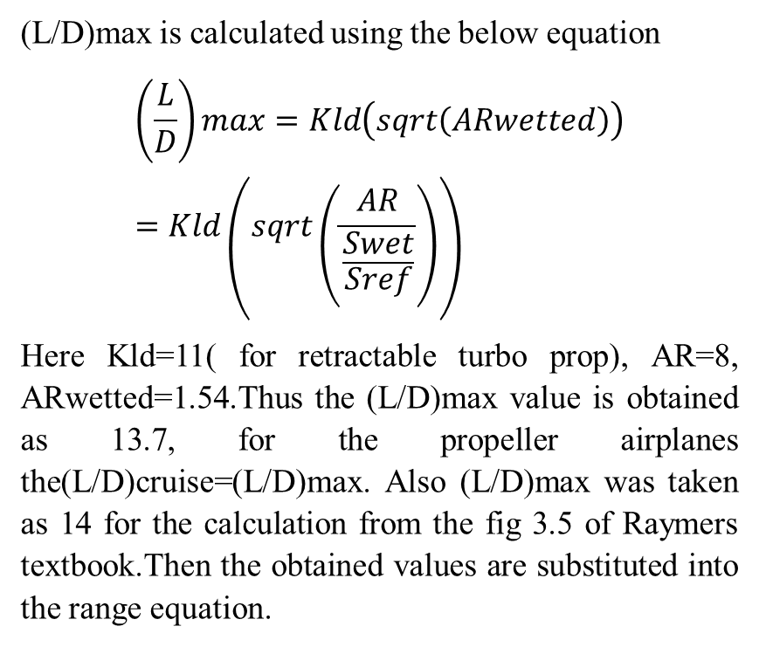
Design Team
(L/D)max is calculated using the below equation
$$\left(\frac{L}{D}\right)max=Kld\left(sqrt\left(ARwetted\right)\right)=Kld\left(sqrt\left(\frac{AR}{\frac{Swet}{Sref}}\right)\right)$$
Here Kld=11( for retractable turbo prop), AR=8, ARwetted=1.54.Thus the (L/D)max value is obtained as 13.7, for the propeller airplanes the(L/D)cruise=(L/D)max. Also (L/D)max was taken as 14 for the calculation from the fig 3.5 of Raymers textbook.Then the obtained values are substituted into the range equation.

Slide 21
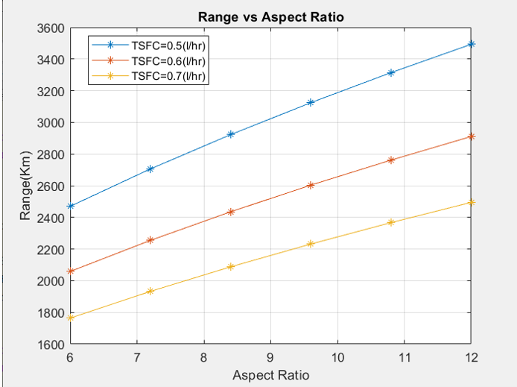
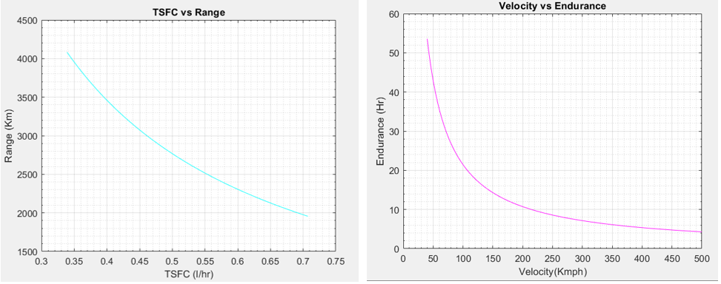
Design Team
Initial Sizing

Slide 22
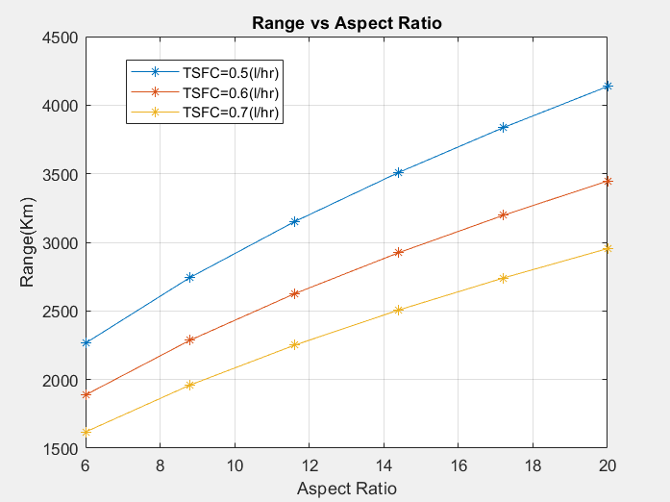
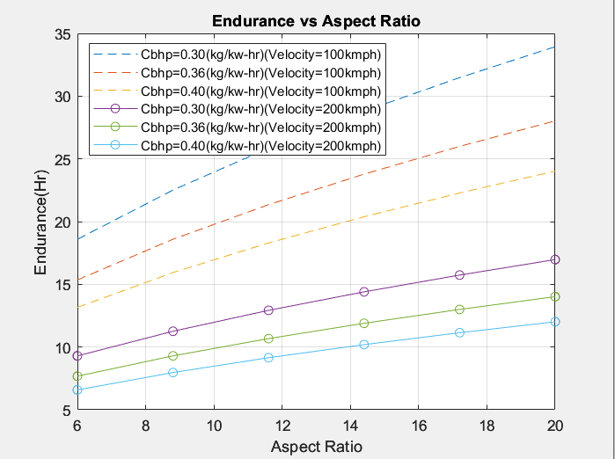
Design Team
Initial Sizing

Slide 23
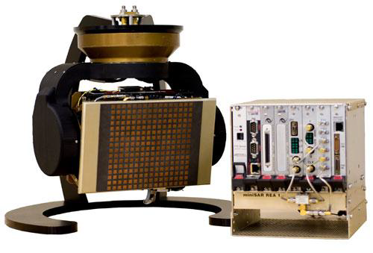
Payload (maximum weight 113kg)
Design Team
Payload
Synthetic Aperture Radar (SAR): Sandia Labs MiniSAR -14 kg
Electro-Optic-Infrared Sensor: 23 kg (APM UAV Payloads)
Data link: (l-3 communications) :1kg

Slide 24
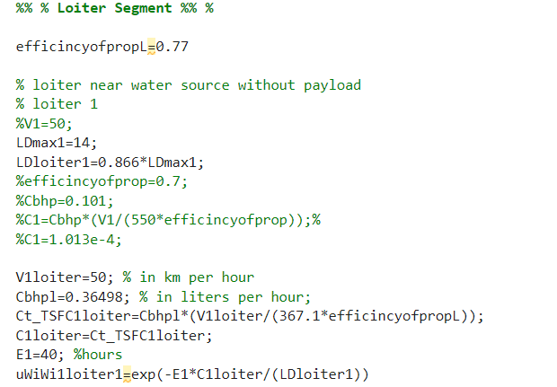
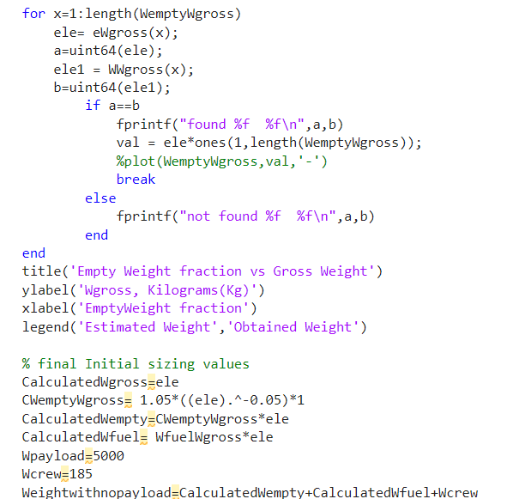
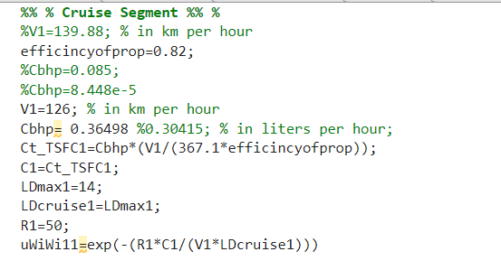
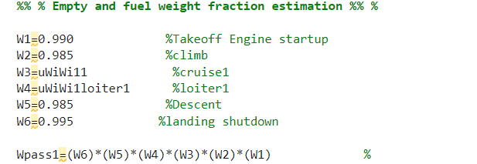
Design Team
Initial Sizing
Presentation Outline

Slide 25
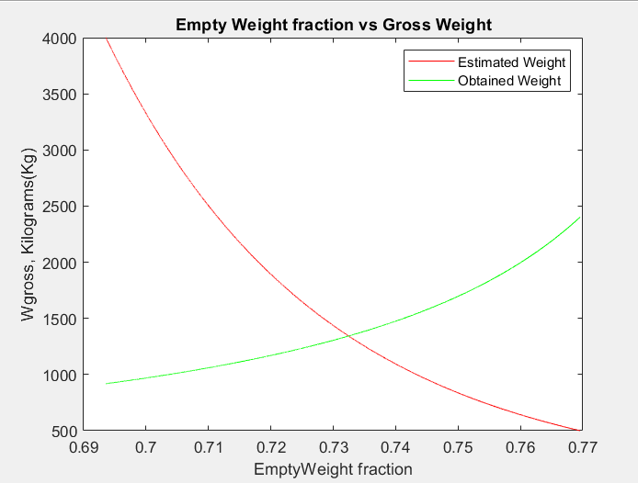
Design Team
Initial Sizing
Presentation Outline
CalculatedWgross = 1.3427e+03 kg
CWemptyWgross = 0.7325
CalculatedWempty = 983.4657 kg
CalculatedWfuel = 246.2315 kg
Wpayload = 113 kg
Wcrew = 0
Weightwithnopayload = 1.2297e+03 kg

Slide 26
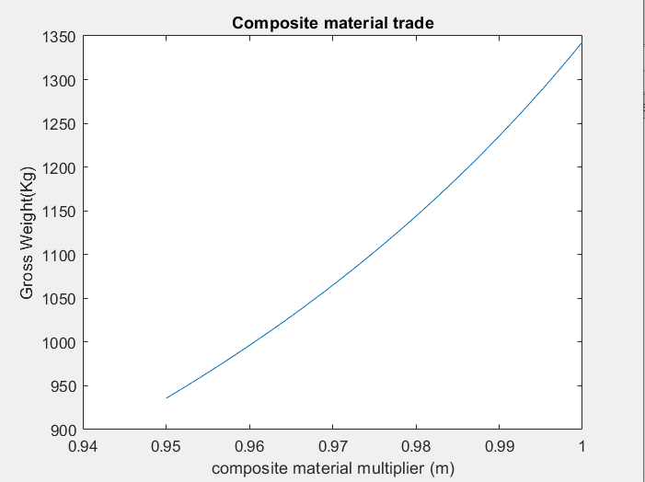
Design Team
Initial Sizing Composite trade
Presentation Outline
CalculatedWgross = 1.3427e+03 kg
CWemptyWgross = 0.7325
CalculatedWempty = 983.4657 kg
CalculatedWfuel = 246.2315 kg
Wpayload = 113 kg
Wcrew = 0
Weightwithnopayload = 1.2297e+03 kg

Slide 27
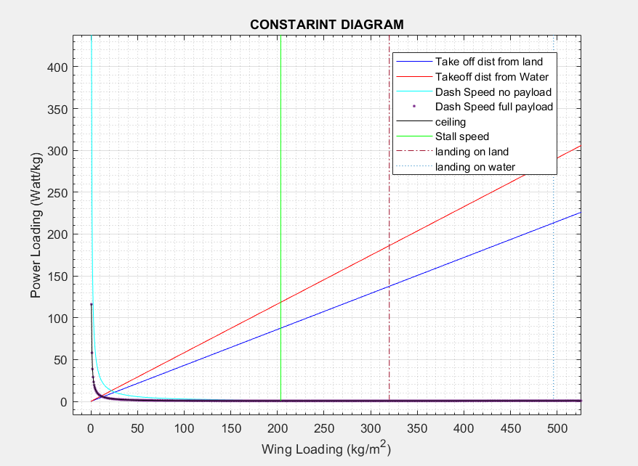
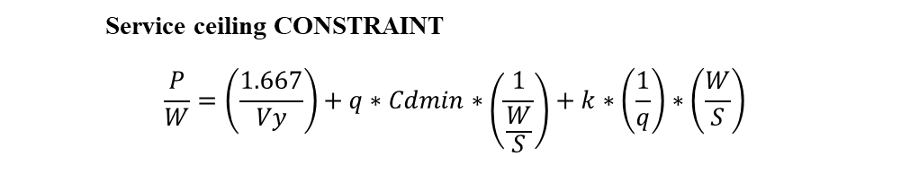
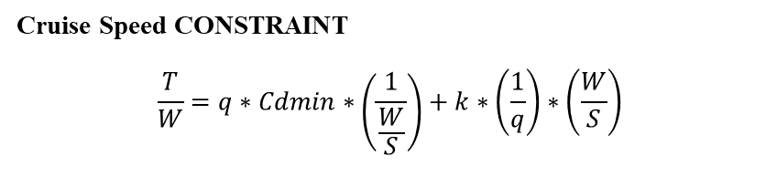

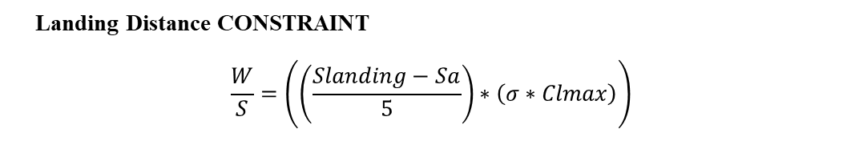
Design Team
Constraint Analysis
Take off CONSTRAINT
$$\frac{P}{W}=\frac{\frac{W}{S}}{TOP∗σ∗{Cl}_{Takeoff}}$$
Cruise Speed CONSTRAINT
$$\frac{T}{W}=q∗Cdmin∗\left(\frac{1}{\frac{W}{S}}\right)+k∗\left(\frac{1}{q}\right)∗\left(\frac{W}{S}\right)$$
Service ceiling CONSTRAINT
$$\frac{P}{W}=\left(\frac{1.667}{Vy}\right)+q∗Cdmin∗\left(\frac{1}{\frac{W}{S}}\right)+k∗\left(\frac{1}{q}\right)∗\left(\frac{W}{S}\right)$$
Stall Speed CONSTRAINT
$$\frac{W}{S}=Clmax∗0.5∗ρ∗{\left(Vsta11\right)}^{2}$$
Landing Distance CONSTRAINT
$$\frac{W}{S}=\left(\left(\frac{Slanding−Sa}{5}\right)∗\left(σ∗Clmax\right)\right)$$

Slide 28
Design Team
Constraint Analysis
Power Loading (P/W) (Watt/kg) | 120.3
Wing Loading (W/S) (Kg/m^2) | 20
Design point

Slide 29
Design Team
Airfoil data Analysis
EPPLER 556 AIRFOIL |  |  |  | NACA 4415 AIRFOIL
 | Mach no-0.05 | Mach no-0.22 |  |  | Mach no-0.05 | Mach no-0.22
Cl max | 1.2574 | 1.83 |  | Cl max | 1.98 | 1.9521
AOA at Cl max | 5 | 19 |  | AOA at Cl max | 15 | 18
Stall AOA |  | 20 |  | Stall AOA | 16.5 | 19
Cl at 0 AOA | 0.6224 | 0.5653 |  | Cl at 0 AOA | 0.5614 | 0.5048
AOA at 0 cl | -4.5 | -4.5 |  | AOA at 0 Cl | -4 | -4
EPPLER 1210 AIRFOIL |  |  |  | NACA 4417 AIRFOIL
 | Mach no-0.05 | Mach no-0.22 |  |  | Mach no-0.05 | Mach no-0.22
Cl max | 2.3612 | 2.1103 |  | cl max | 1.905 | 1.9118
AOA at Cl max | 14 | 14.1 |  | AOA at Cl max | 15.5 | 18.5
Stall AOA | 15 | 14.4 |  | Stall AOA | 16.5 | 19.5
Cl at 0 AOA |  | 0.5839 |  | Cl at 0 AOA | 0.562 | 0.5057
AOA at 0 Cl | -4.5 | -4.8 |  | AOA at 0 cl | -4 | -4
EPPLER 561 AIRFOIL |  |  |  | NACA 23012 AIRFOIL
 | Mach no-0.05 | Mach no-0.22 |  |  | Mach no-0.05 | Mach no-0.22
Cl max | 1.581 | 1.889 |  | Cl max | 1.8608 | 1.3818
AOA at Cl max | 7 | 15.5 |  | AOA at Cl max | 13 | 37.5
Stall AOA |  | 16.5 |  | Stall AOA |  | 40
Cl at 0 AOA | 0.8438 | 0.7591 |  | Cl at 0 AOA | 0.1567 | 0.1396
AOA at 0 Cl | -6 | -6 |  | AOA at 0 cl | -1 | -1

Slide 30
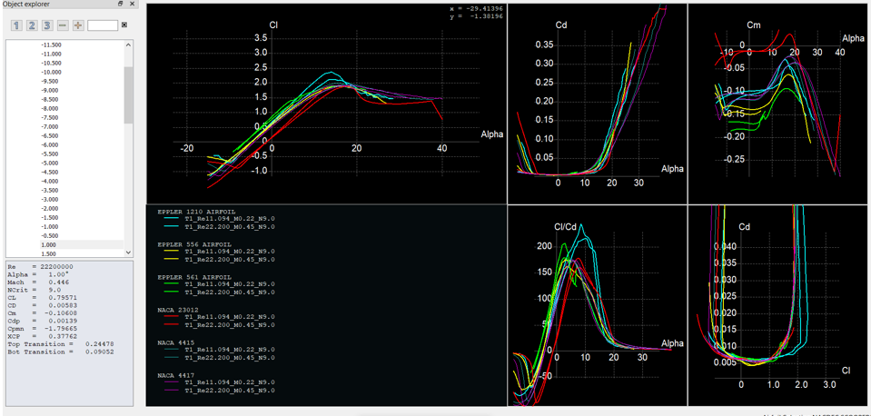
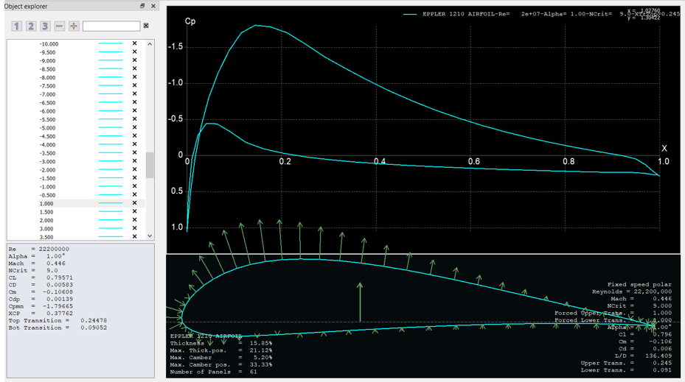
Design Team
Airfoil XFLR Analysis

Slide 31
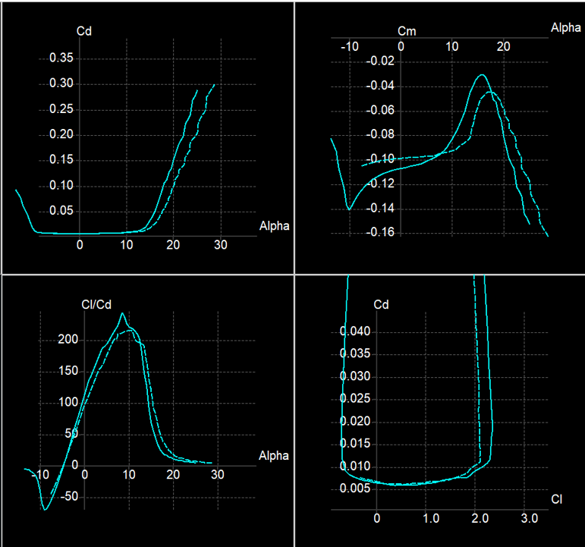
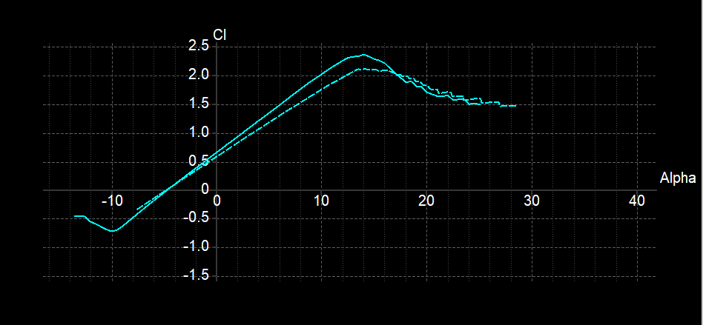
Design Team
Airfoil XFLR Analysis

Slide 32
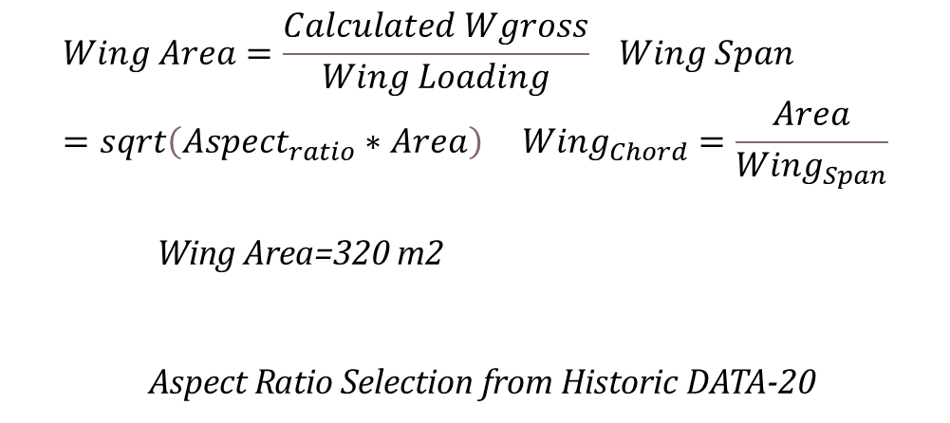
Design Team
Wing Sizing
Overall Wing/Fuselage Arrangement- Middle Wing Config
Wing Figures of Merit
Low manufacturing cost
low weight
ease of training
ease of inspection and accessibility
good aerodynamics characteristics and reliable stall behaviour
fatigue and structural considerations
good flight handling quality
$$Wing Area=\frac{Calculated Wgross}{Wing Loading} Wing Span=sqrt\left(Aspect_{ratio}∗Area\right) Wing_{Chord}=\frac{Area}{Wing_{Span}}$$
Wing Area=320 m2
Aspect Ratio Selection from Historic DATA-20

Slide 33
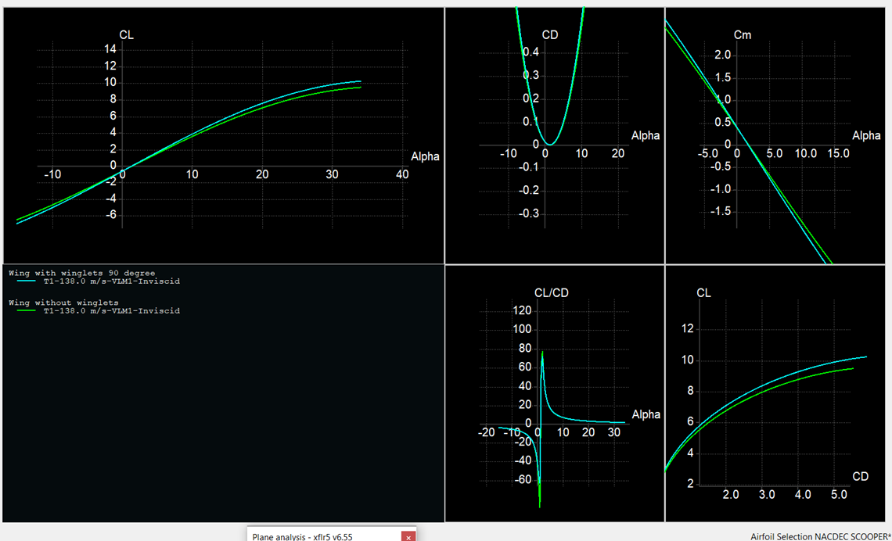
Design Team
Wing Analysis
Span(b)(m) | 80.1943
Chord(c)(m) | 4.1493
Aspect Ratio(AR) | 20
Wing Area(S)(m^2) | 137.734
Taper Ratio | 1
Airfoil | Eppler 1210
Thickness Ratio(t/c) | 0.159
Sweep | 3

Slide 34


Design Team
Span Efficiency Factor
$$e=(\left(1+0.12∗M^{6}\right){\left(1+\left(\frac{0.142+f\left(λw\right)∗AR∗{\left(10∗\left(\frac{t}{c}\right)w\right)}^{0.33}}{\cos^{2}\left(Λquartersweep\right)}\right)+\left(\frac{0.1\left(3Ne+1\right)}{{\left(4+AR\right)}^{0.8}}\right)\right)}^{−1}$$
Oswald’s Efficiency factor

Slide 35

Design Team
Powerplant Selection
Since the flight speed regime is under subsonic level apart from that, in order to decrease the fuel consumption and increase the efficiency, selection of BLDC Motor engine will be good option. From the obtained constraint diagram,
we know that Power Loading=120.3 watt/kg
$$Power_{Required}=Power Loading∗Calculated Wgross$$
$Power_{Required}=$1,56,390 Watt

Slide 36

Design Team
Powerplant Selection
When the fuel (usually Hydrogen) enters the anode it becomes a positively charged ion and a negatively charged electron. The electrolyte is designed so that the ions produced can pass directly through it, but the electrons cannot. The trapped electrons pass through an electrical system and in result create electrical energy. Once the ions pass the electrolyte and enter the cathode they are met with a third chemical (usually Oxygen) and create water (H2O) or carbon dioxide (CO2) as an emission.

Slide 37

Design Team
Powerplant Selection
Fuel cells of this type will dramatically play a major role in the overall weight. A typical fuel cell system can be almost 25% - 50% lighter than a battery system . Previous research has shown that the energy density of a standard H₂ – O₂ fuel cell can range between 0.450 – 0.650 kWh/kg . The space shuttle uses three H₂ – O₂ fuel cells, which weigh approximately 150 lbs each; which generate 60kW of continuous power, and 65kW peak. For this matter our UAV shall implement three fuel cells similar to that of the space shuttle

Slide 38


Design Team
Powerplant Selection
To achieve higher thrust without sacrificing high amounts of energy, electric motors shall be used to power the UAV. Electric motors are generally expressed in units of horsepower (hp), which is defined as:
Where T0 is the required torque and ω is the angular velocity. For efficiency purposes, brushless DC electric (BLDC) motors were chosen. Brushless DC motors use permanent magnets which are used to rotate a fixed rotor and/or arm; this increases reliability, efficiency, power, and reduces noise. The characteristics of a standard BLDC with respect to the speed and torque can be found as shown.

Slide 39
Design Team
Powerplant Selection
It has been found that using rare earth magnets such as Samarium Cobalt (Sm-Co) reduces the amount of electromagnetic interference which is present in conventional electric motors. Sm-Co BLDC motors are have been implemented on the Space Shuttle elevons. The motor produces approximately 12.9 kW (17.1 hp) at 9,000 rev/min and weighs approximately 10 lbs. In recent tests Sm-Co BLDC motors have recorded an operating efficiency of 95%; this is due to its high magnetic density. The BLDC motors shall be conjoined with an appropriate speed reduction control system in order to drive relatively large, slow turning propellers.

Slide 40


Design Team
Configuration -1

Slide 41

Design Team
Configuration -1

Slide 42


Design Team
Configuration-1

Slide 43


Design Team
Configuration-2

Slide 44

Design Team
Configuration-2

Slide 45


Design Team
Configuration-2

Slide 46


Design Team
Configuration-3

Slide 47

Design Team
Configuration-3

Slide 48


Design Team
Constraint Analysis

Slide 49



Design Team
StabilityAnalysis
Configuration-1
Configuration-2
Configuration-3

Slide 50
Design Team
Conclusion:
Presentation Outline
The main goal of this assignment was the analyses of HALE unmanned aerial vehicles designed for extended flight operations at high altitudes. The main interest of the study was the focus on utilising an conventional wing tail configuration for high altitude applications.

Slide 51
Design Team
References:
1] Justin Murphy. Military Aircraft Origins to 1918, chapter 1. ABC CLIO, 2005.
[2] Jim Garamone. From U.S. Civil War to Afghanistan: A Short History of UAVs. http://www.defense.gov/news/newsarticle.aspx?id=44164, 2002. Accessed: 2015-05-19.
[3] The Ryan Firebee: Grandfather to the Modern UAV. http://gizmodo.com/the-ryan-firebeegrandfather- to-the-modern-uav-1155938222, 2013. Accessed: 2015-11-11.
[4] Consistent Growth for UAV Market to Push Industry Above $ 10 Billion Mark by 2024, IHS Says. http://press.ihs.com/press-release/aerospace-defense-security/consistent-growth-uavmarket- push-industry-above-10-billion, October 2015. Accessed: 2015-10-15.
[5] TEKEVER drone tracks lava flow at Pico do Fogo volcano capturing dazzling images. http://tekevernews.blogspot.pt/2015/01/tekever-drone-tracks-lava-flow-at-pico.html, January 2015. Accessed: 2015-10-19.
[6] Tecnologia da Universidade de Aveiro p˜oe drone a vigiar as florestas. http://www.publico.pt/tecnologia/noticia/tecnologia-da-universidade-de-aveiro-poe-drone-avigiar- as-florestas-1693988, April 2015. Accessed: 2015-10-19.
[8] DHL parcelcopter launches initial operations for research purposes. http://www.dhl.com/en/press/releases/releases 2014/group/dhl parcelcopter launches initial operations for research purposes.html, September 2014. Accessed: 2015-10-16.
Presentation Outline
Hale UAV
Objectives
UAV Comparision
Design Methodology
Conclusion
Reference

